Slide 1
CLeANING WATER BODIES USING SENSOR AND MOTOR
Team Members:
1) G.Spandana
2) A.Anagha
3) N.Srilatha
4) S.Prathima

Slide 2
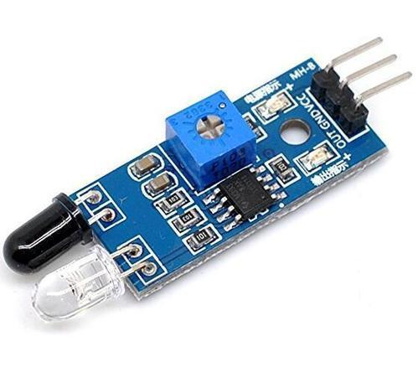
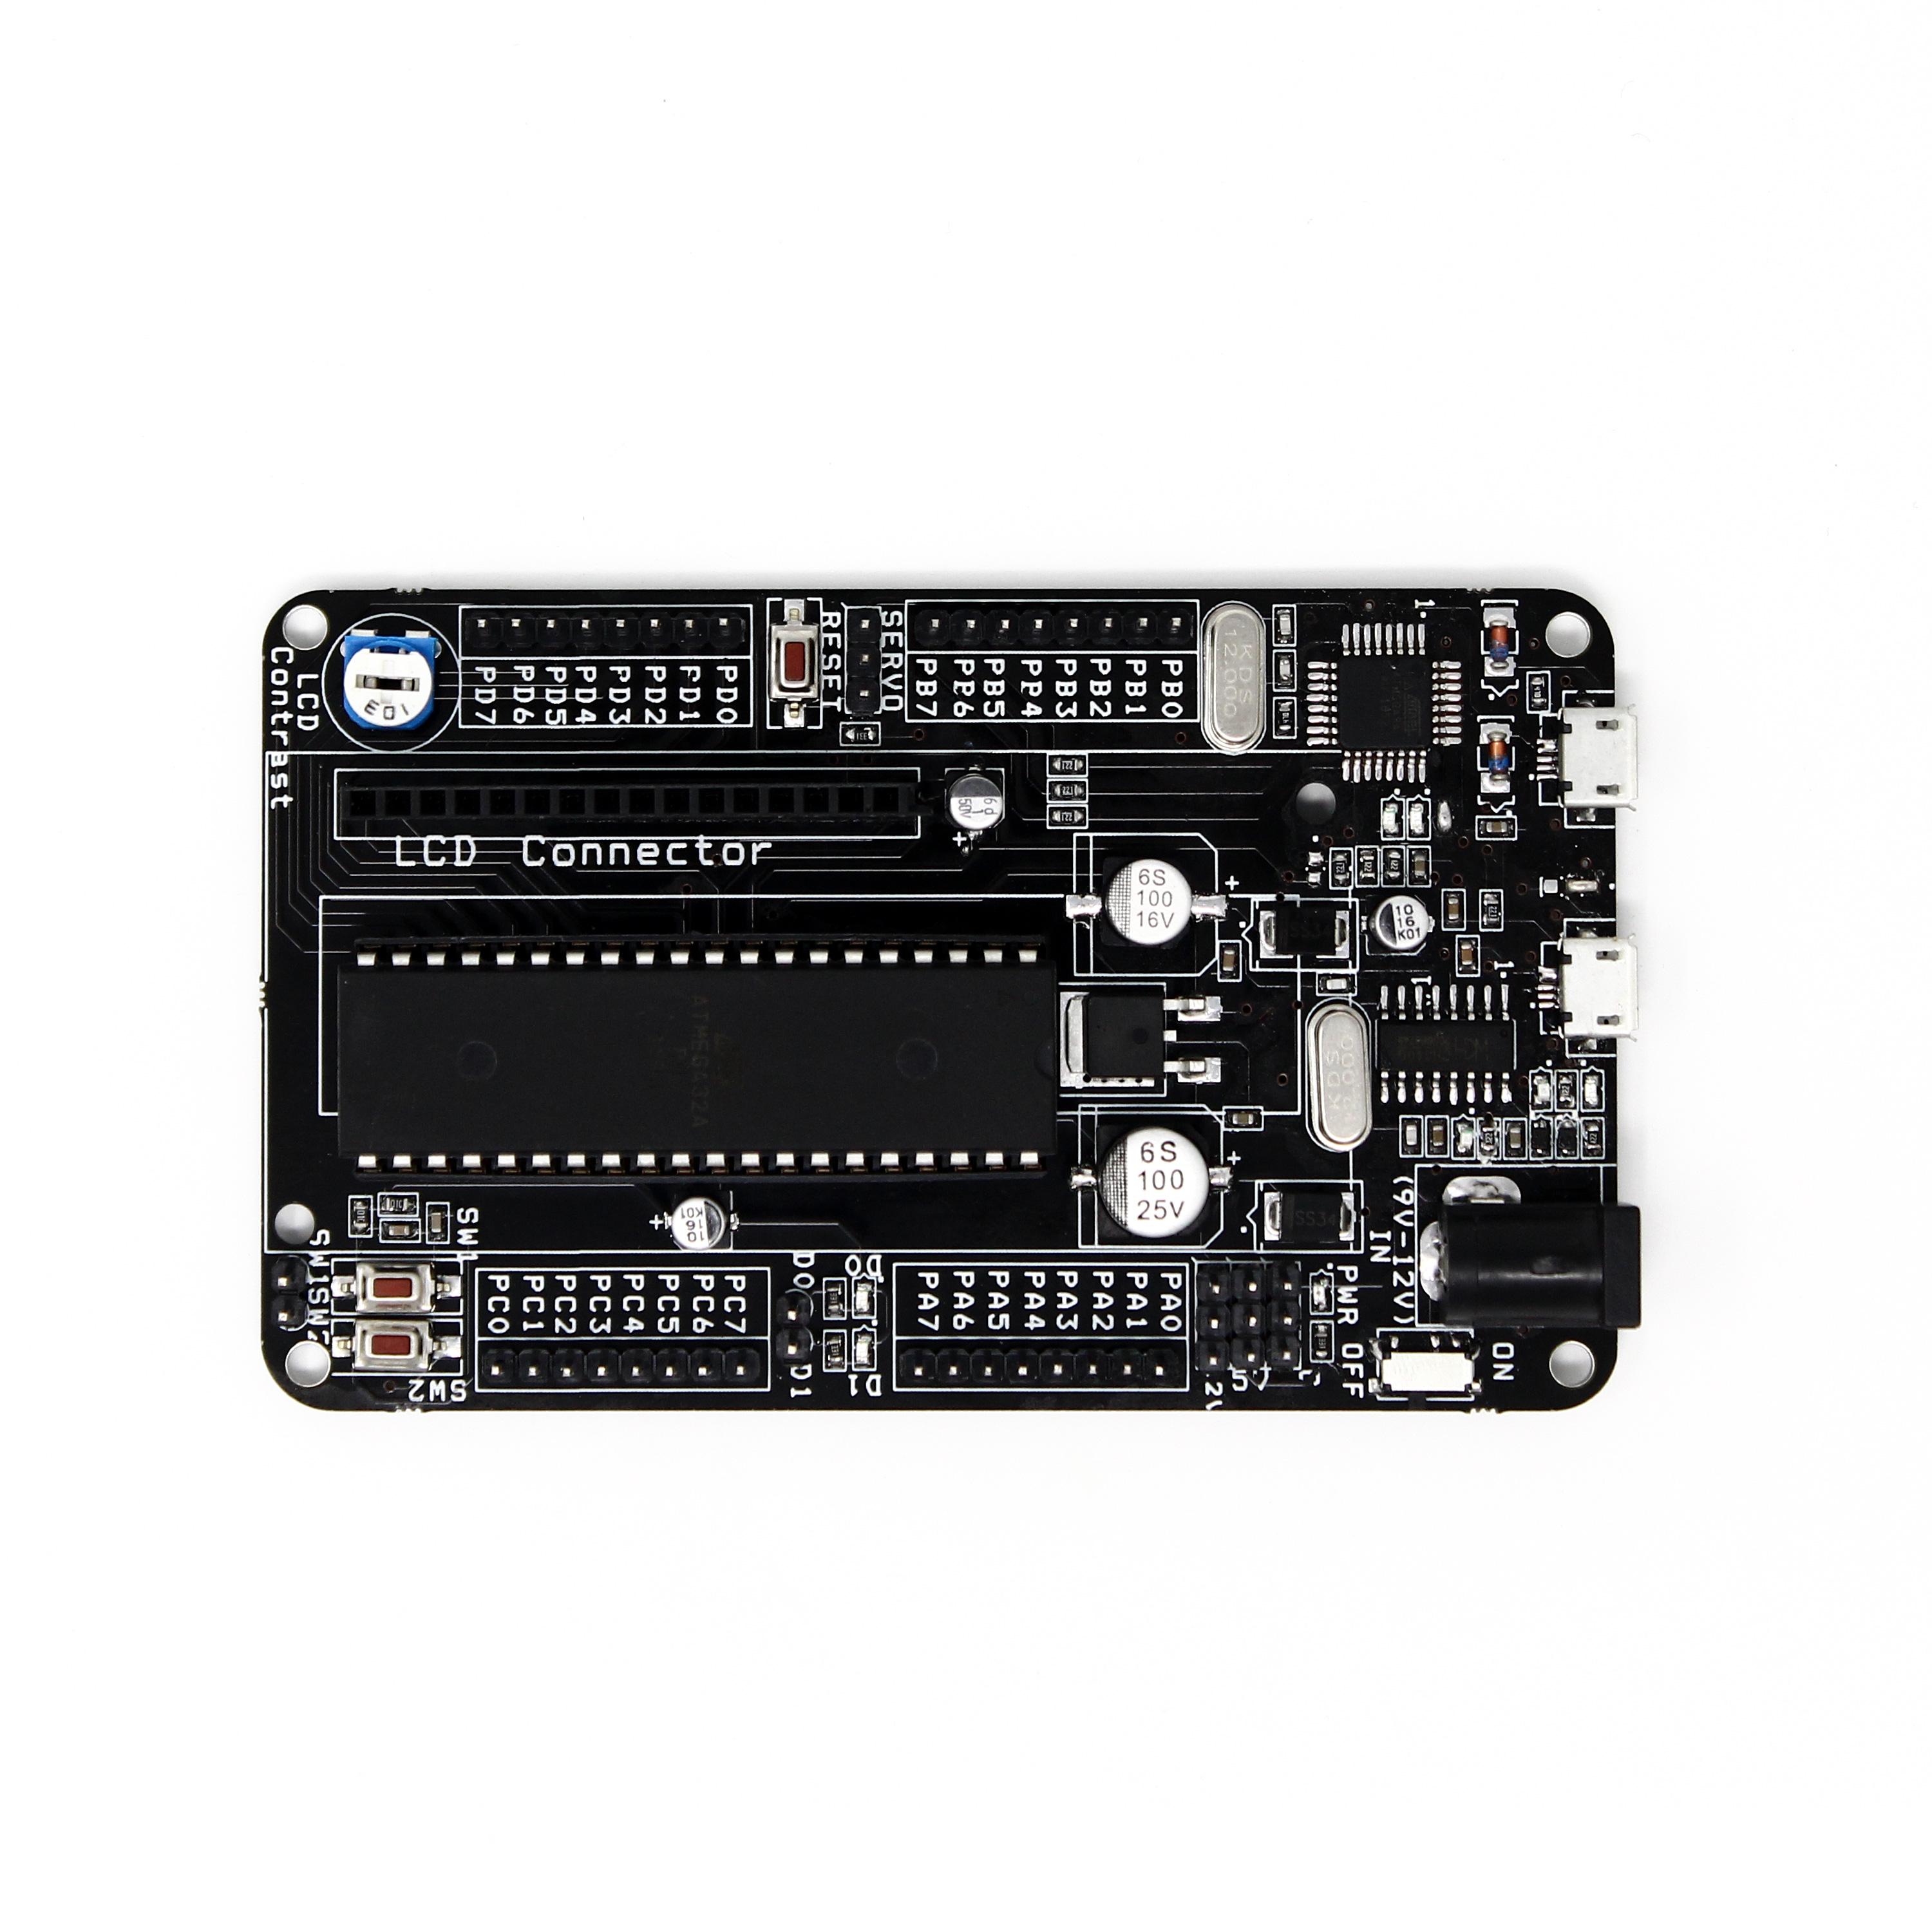
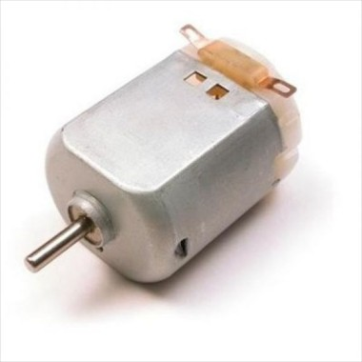
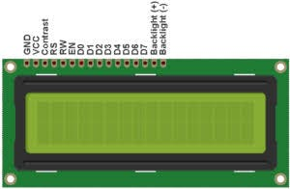
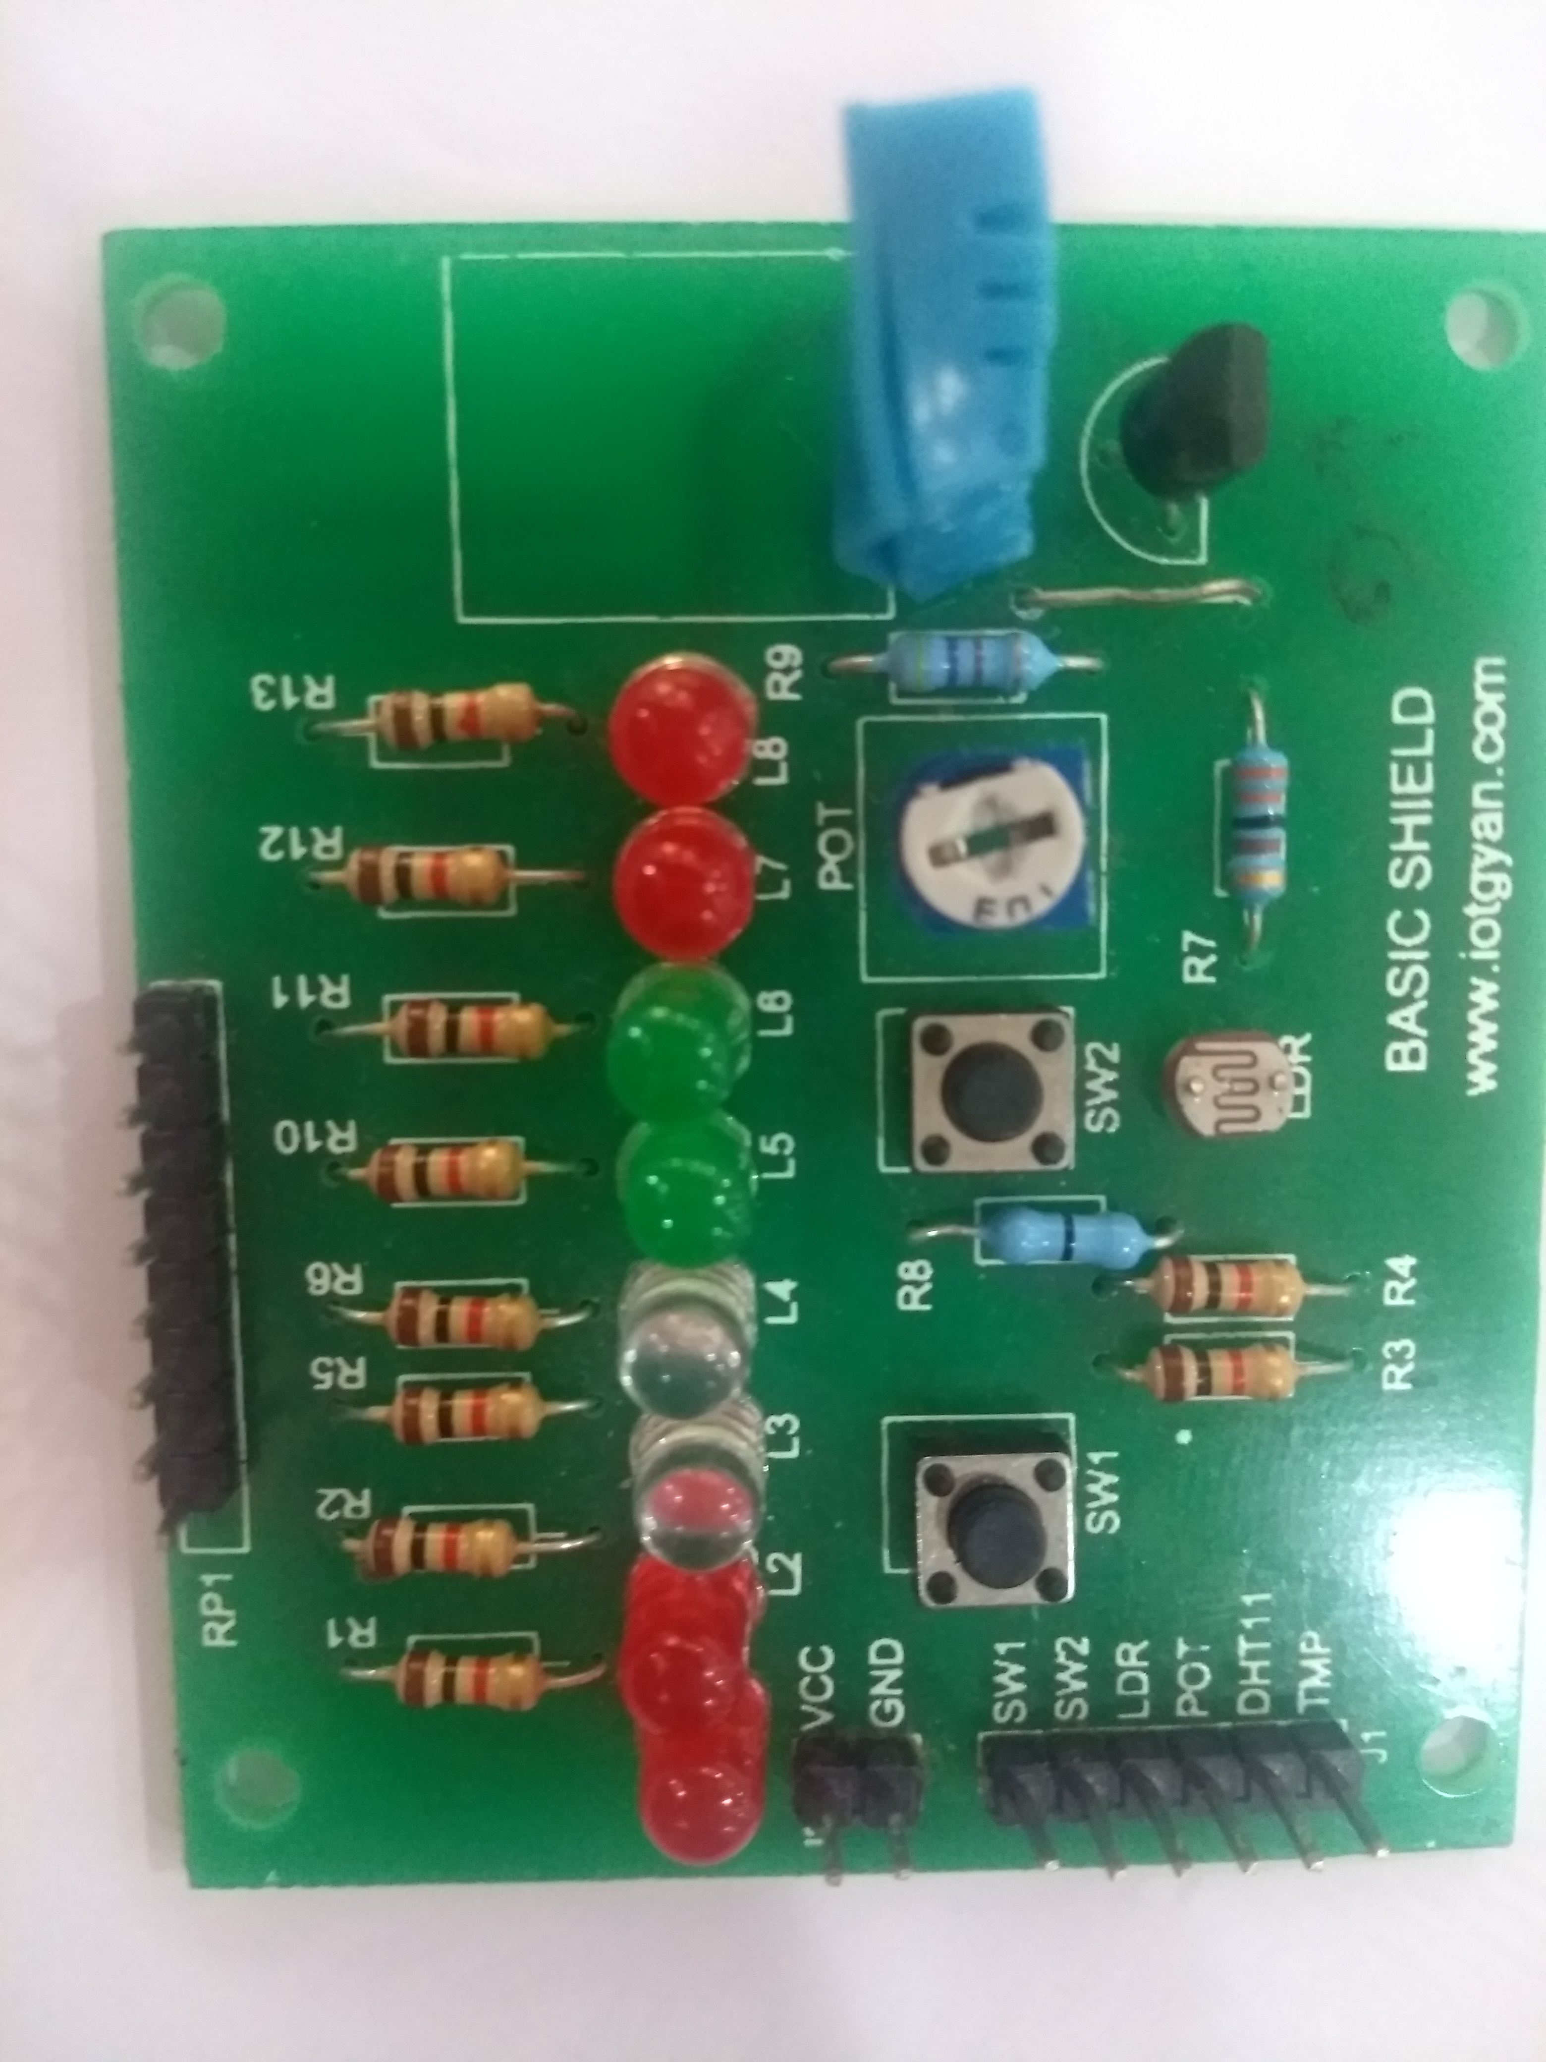
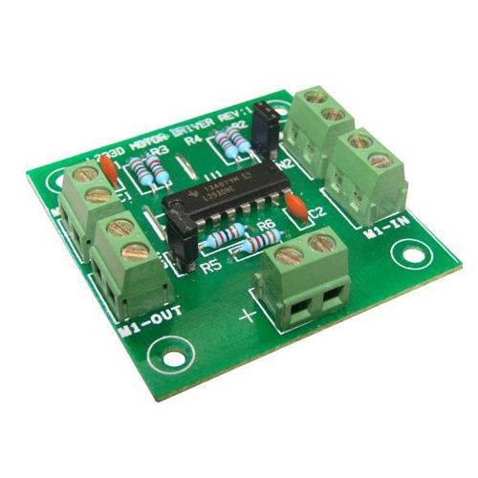
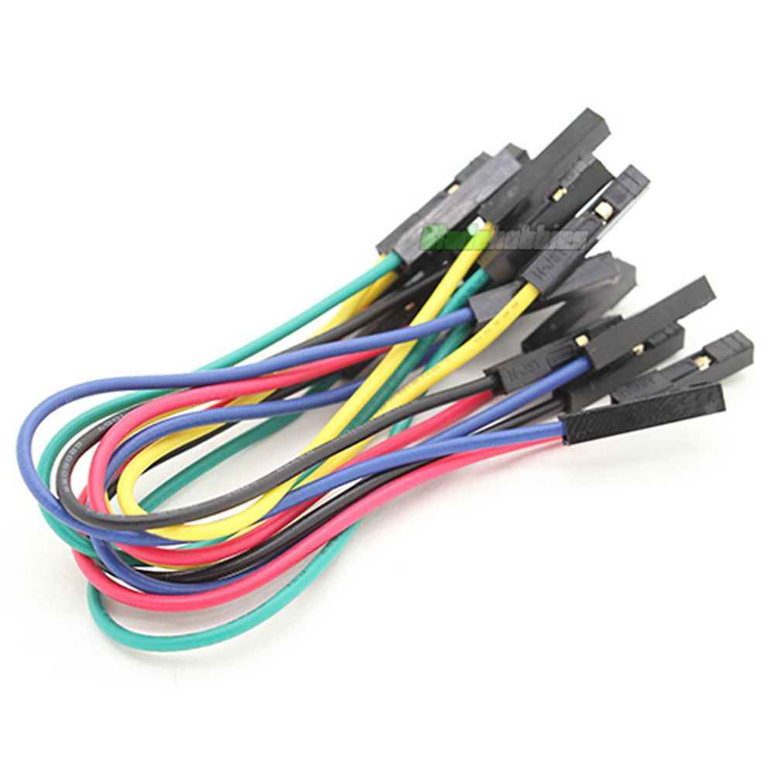
Components used
IR sensor
L2933D motor
driver
3) Basic shield
4) At mega32
microcontroller
5) DC motor
6) LCD
7) Connecting wires
8) USB cable

Slide 3
Block diagram
Power Supply
IR Sensor
ATmega32
Microcontroller
LED
LCD
DC motor

Slide 4
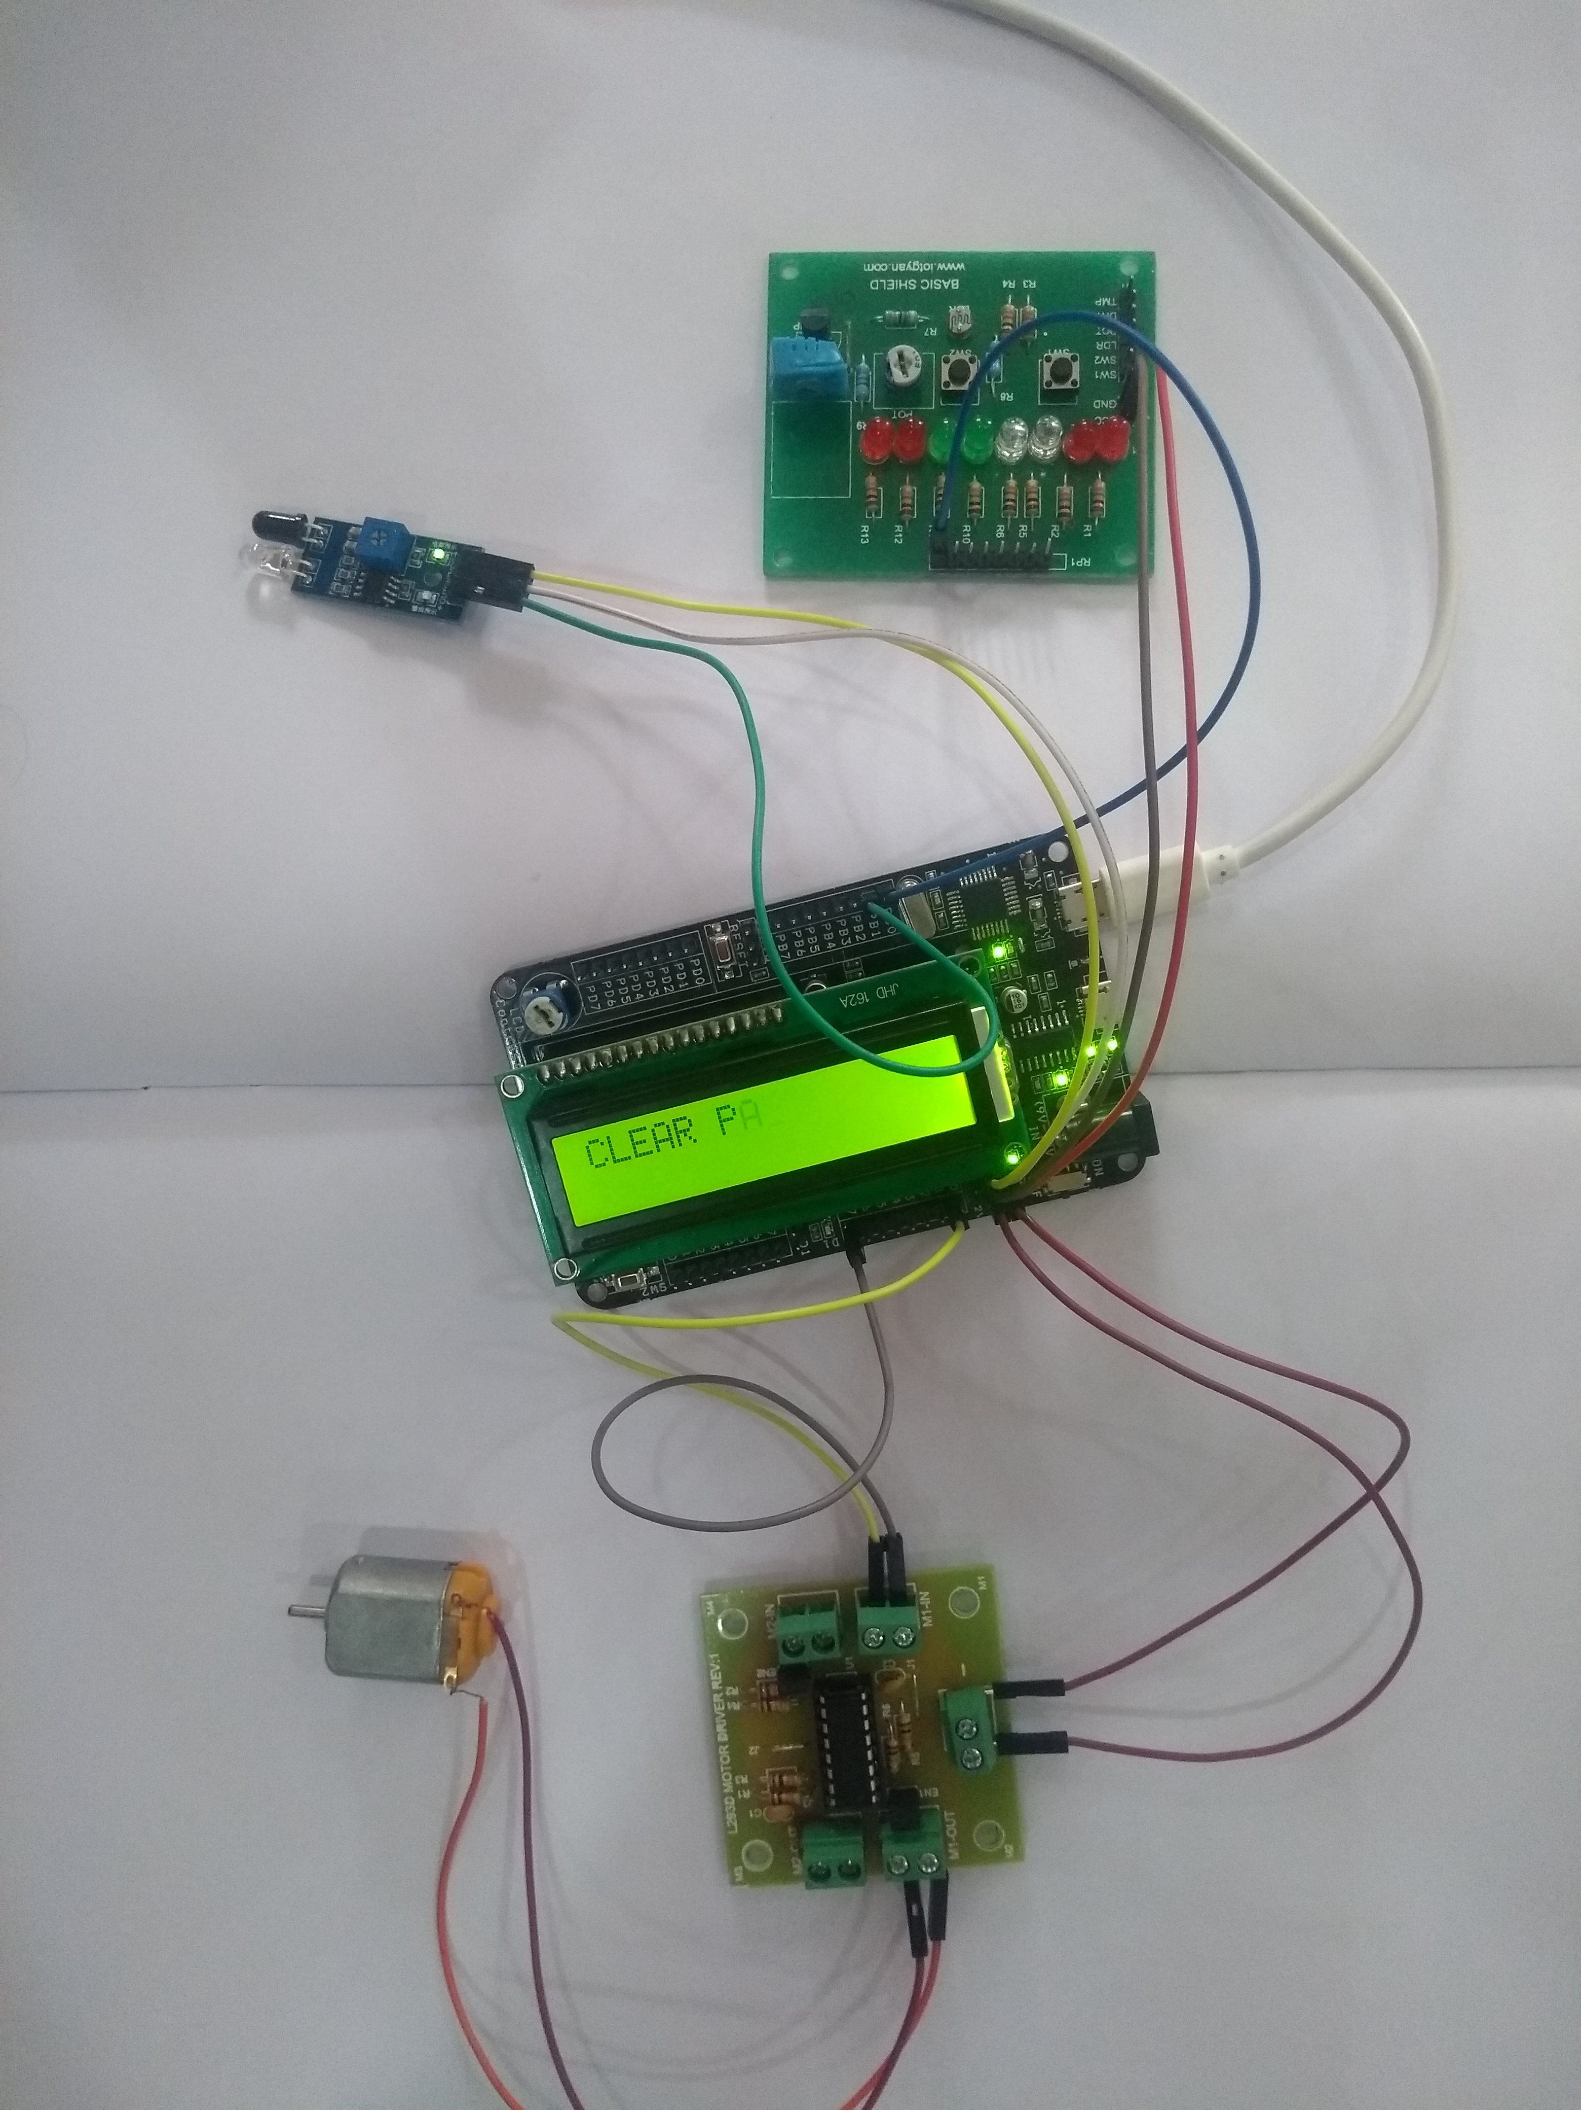
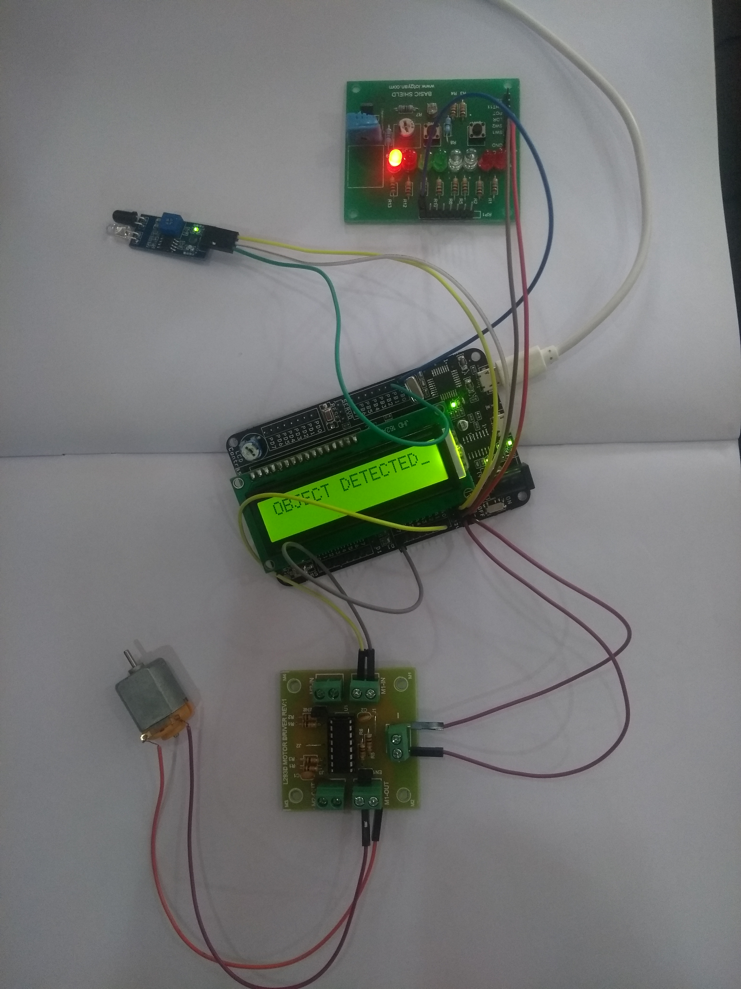
Circuit diagram
CLEAR PATH
OBJECT DETECTED

Slide 5
Algorithm
1)Connect power to atmega32 development board.
2)Connect Vcc , ground and input from IR sensor to specified pins on development board.
3)Assign output port to LCD ,DC motor and LED.
4)Whenever a object is detected output port goes high.
5)hence, LED glows, LCD displays information and motor starts rotating.

Slide 6
Flow chart
Start
IR sensor
Sensor detects object
LED high
LED low
LCD displays object detected
LCD displays clear path
Motor rotates
Motor is off
End

Slide 7
code
#ifndef F_CPU
#define F_CPU 16000000UL
#endif
#include <util/delay.h>
#include <avr/io.h>
#define enable 5
#define registerselection 7
void send_a_command(unsigned char command);
void send_a_character(unsigned char character);
void send_a_string(char *string_of_characters);
void LCD();
void dcmotor();

Slide 8
int main(void)
{
PORTB = 0x00; //input port
DDRA = 0xFF;
DDRC=0XFF;
DDRD=0XFF;
DDRB = 0x01; // Portb.0 = output
while (1)
{
if((PINB & 0x02) != 0) // read PINB.1
{
PORTB &= 0b11111110; // clear PORTB.0
send_a_command(0x01);//all clear command
send_a_command(0x38);//16*2 line LCD
send_a_command(0x0E);//screen and cursor on
send_a_string("CLEAR PATH");
}

Slide 9
else
{
PORTB |= 0b00000001; // set PORTB.0
LCD();
dcmotor();
}
}
}
void LCD()
{
send_a_command(0x01);//all clear command
send_a_command(0x38);//16*2 line LCD
send_a_command(0x0E);//screen and cursor on
send_a_string("OBJECT DETECTED");
}
void dcmotor()
{

Slide 10
PORTA=0x01;
_delay_ms(4000);
PORTA=0x00;
_delay_ms(4000);
PORTA=0x02;
_delay_ms(4000);
PORTA=0x00;
_delay_ms(4000);
}
void send_a_command(unsigned char command)
{
PORTC=command;
PORTD&=~(1<<registerselection);
PORTD|=(1<<enable);
_delay_ms(50);
PORTD&=~(1<<enable);
PORTC=0;
}

Slide 11
void send_a_character(unsigned char character)
{
PORTC=character;
PORTD|=(1<<registerselection);
PORTD|=(1<<enable);
_delay_ms(50);
PORTD&=~(1<<enable);
PORTC=0;
}
void send_a_string(char *string_of_characters)
{
while(*string_of_characters>0)
{
send_a_character(*string_of_characters++);
}
}

Slide 12
Real time application of the project
For practical application of this project, the following modifications are to be done:
The IR sensor used should be replaced with proximity sensors.
A proximity sensor is a sensor which emits a beam of electro magnetic radiation and looks for changes in the return signal. Different proximity sensor targets demand different sensors.
Our aim in this project is to detect plastic objects and heavy metals. A capacitive proximity sensor is suitable for a plastic target and an inductive proximity sensor is suitable for a metal target.
2) The dc motor should be replaced with servo motor.

